Slide 1

Sensor Kit (Kit 1)
ZAS Robotics Training

Slide 2



Sensor Kit - Contents
Sensor Kit Components
Sensor Creative Board

Slide 3



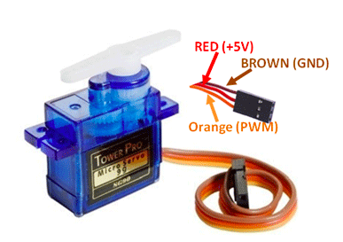
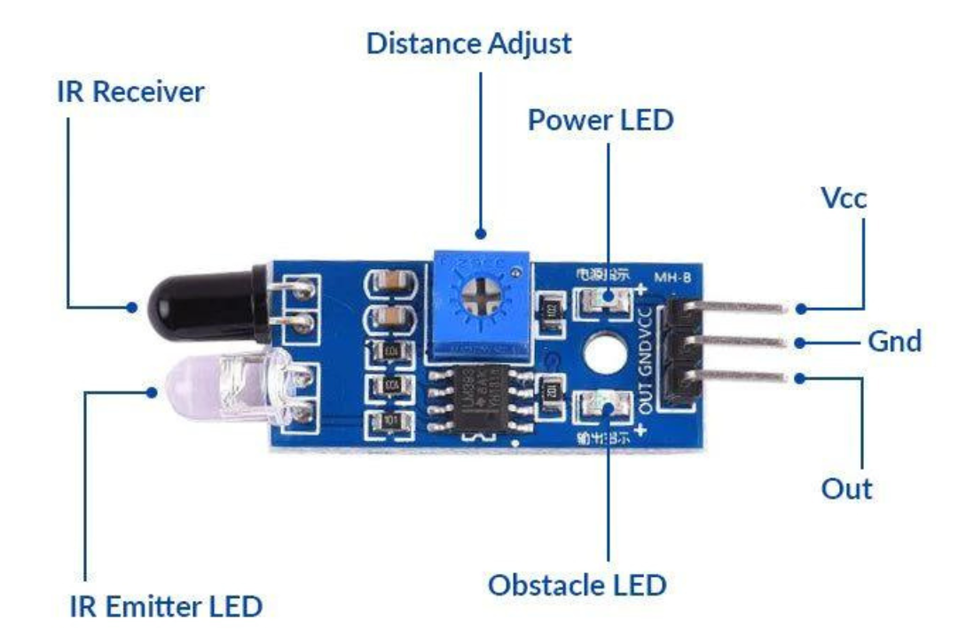

SFL07: IR SENSOR WITH SERVO MOTOR
Things Needed

Slide 4
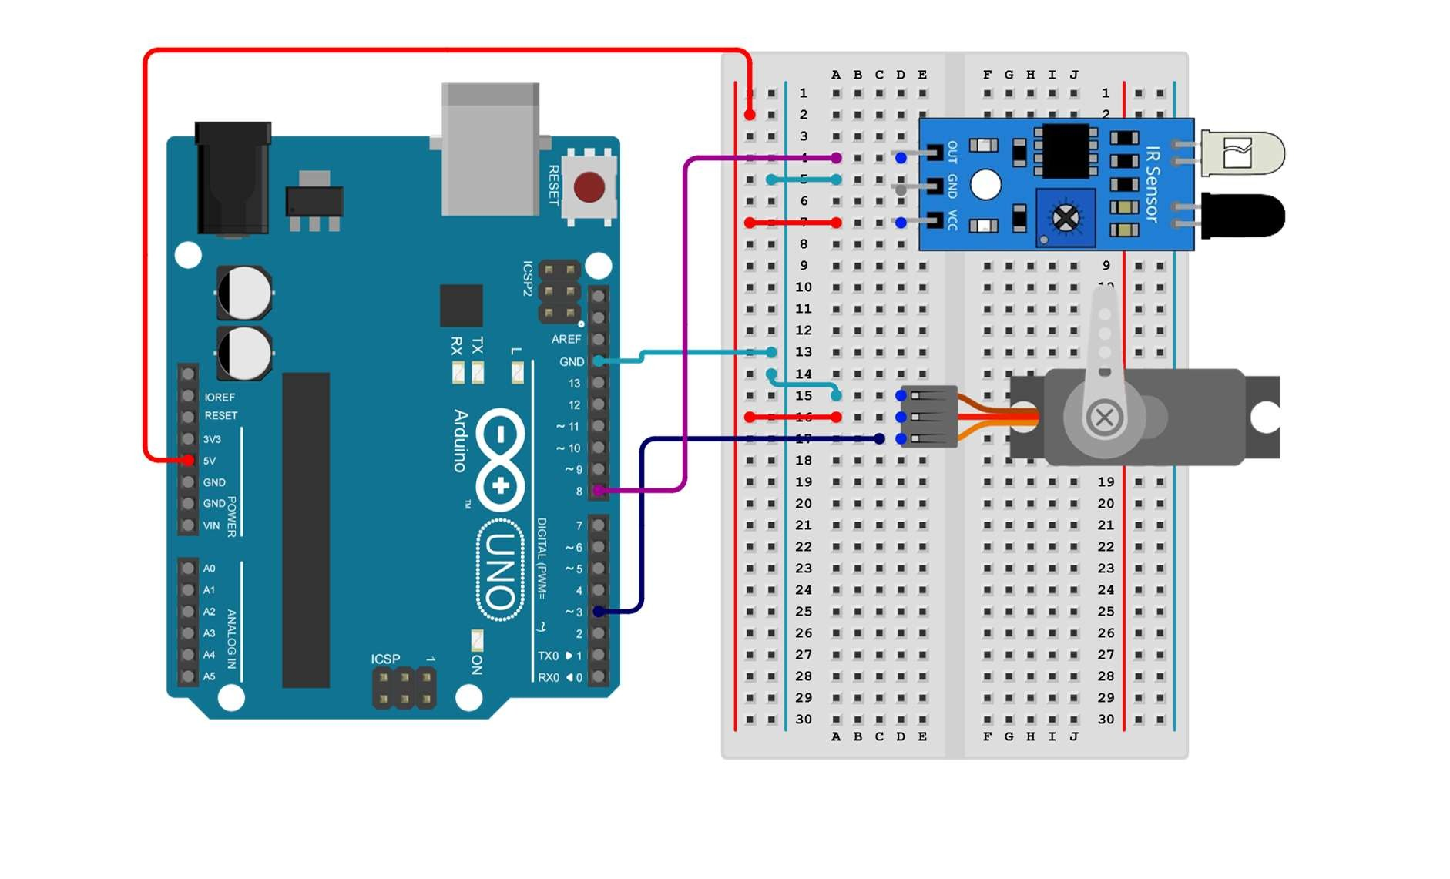
SFL07: IR SENSOR WITH SERVO MOTOR
Connections:
Arduino pins | Bread board
5V | VCC(red)
GND | GND(light blue)
Pin 3 | Output(dark blue)
Arduino pin | breadboard
Pin 8 | Output pin(IR)
GND | GND(red line)
5V | VCC(light blue)

Slide 5
SFL07: IR SENSOR WITH SERVO MOTOR
Include servo library and define pins
Setup()
GND to GND from modules to Arduino
VCC to 5V
pin 3 to servo signal
pin 8 to the IR sensor output
Loop()
IR transmits a signal and controls the servo motor movements
Code for Lesson SFL07:
https://github.com/info-zas/zas-robotics-sensors/blob/main/01_FoundationProjects/01_Code/_07_IRTransmitterAndReceiverWithServoControl/_07_IRTransmitterAndReceiverWithServoControl.ino

Slide 6
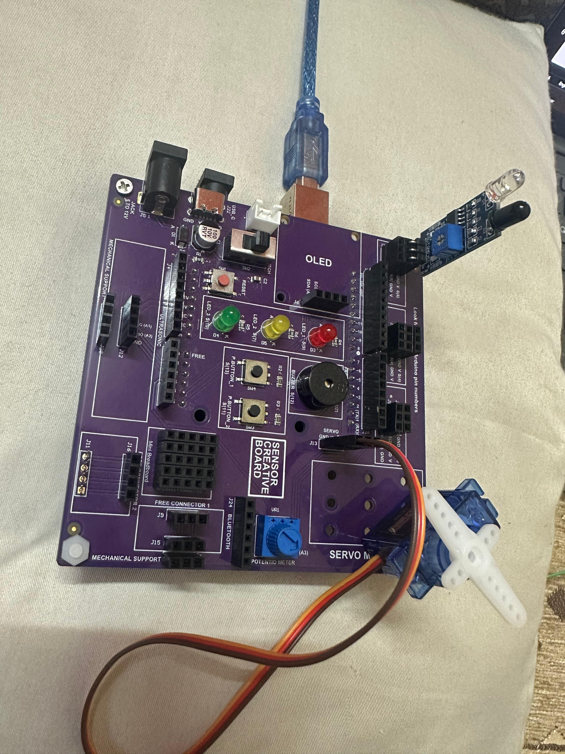
SFL07: IR SENSOR WITH SERVO MOTOR

